Slide 1

Energy – Helmets 1

Slide 2
Energy – Helmets 2

Slide 3
Energy and Oscillations

Slide 4
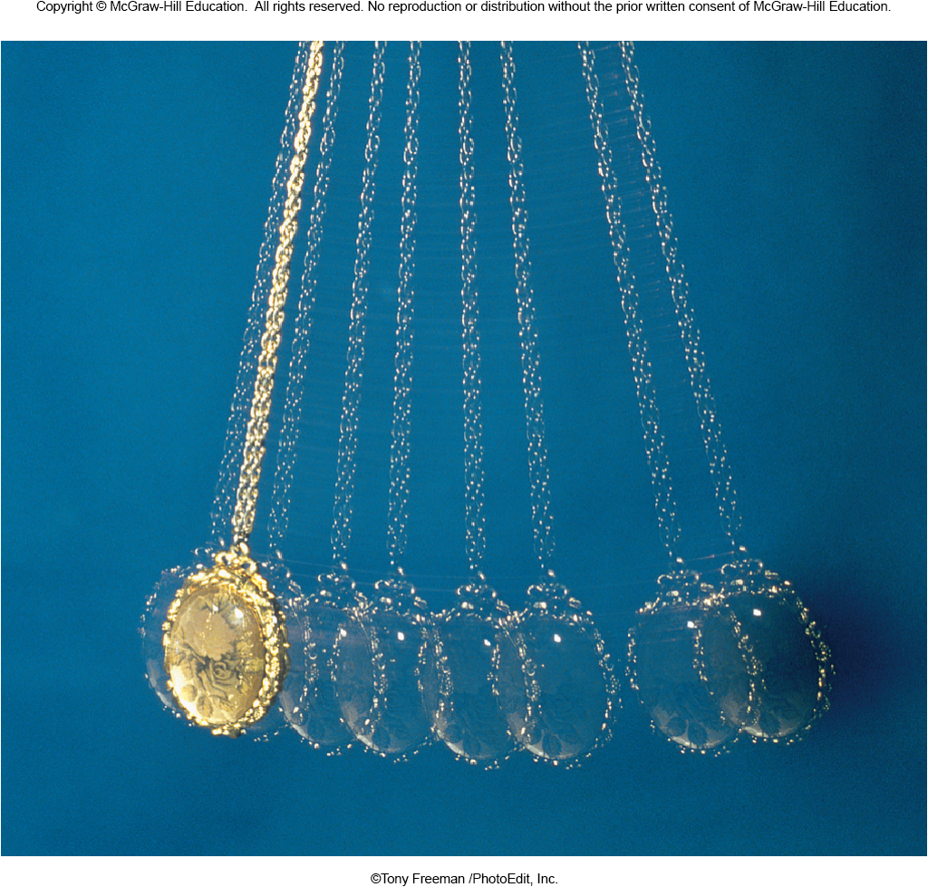
Energy and Oscillations
Why does a swinging pendant return to the same point after each swing?

Slide 5
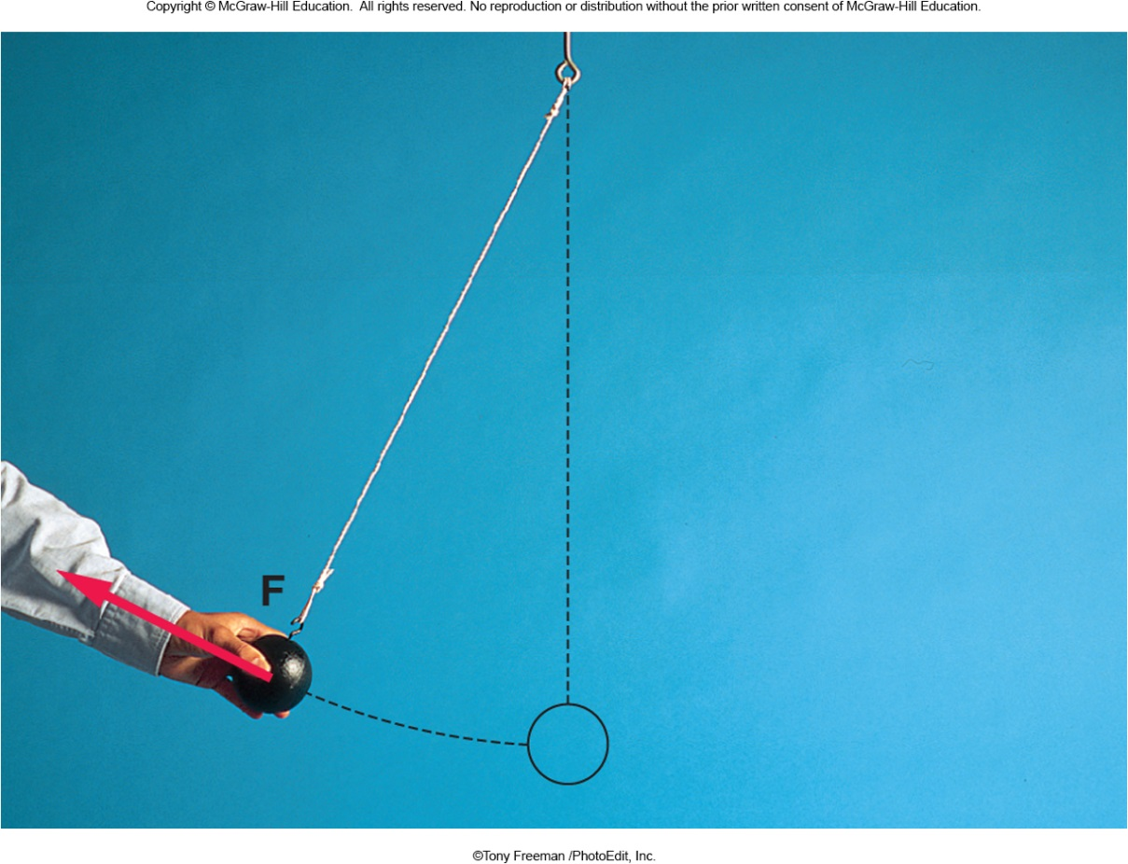
Energy and Oscillations
The force does work to move the ball. This increases the ball’s energy, affecting its motion.

Slide 6
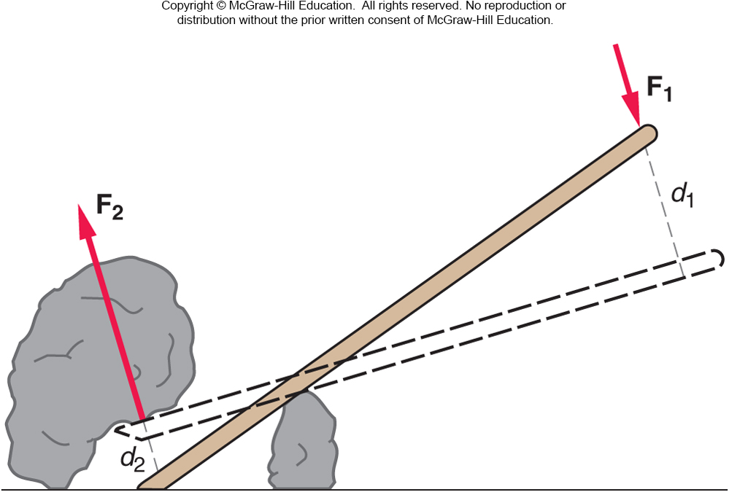
Simple Machines, Work, and Power
A simple machine multiplies the effect of an applied force.
For example, a lever :
A small force applied to one end delivers a large force to the rock.
The small force acting through a large distance moves the rock a small distance.

Slide 7
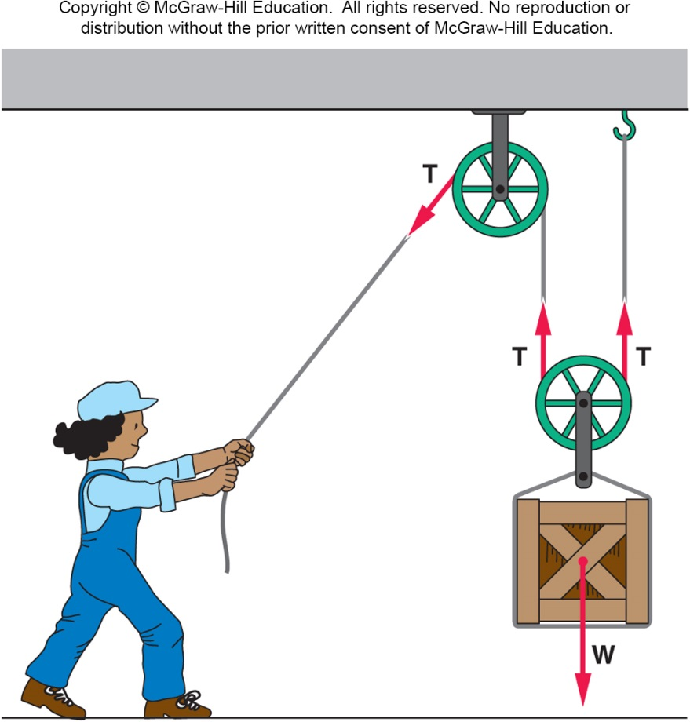
Simple Machines, Work, and Power
A simple machine multiplies the effect of an applied force.
For example, a pulley :
A small tension applied to one end delivers twice as much tension to lift the box.
The small tension acting through a large distance moves the box a small distance.

Slide 8
Simple Machines, Work, and Power
The mechanical advantage of a simple machine is the ratio of the output force to the input force.
For this pulley example, the mechanical advantage is 2.

Slide 9
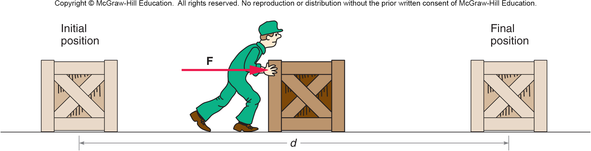
Work is equal to the force applied times the distance moved.
Work = Force x Distance: W = F d
Work output = Work input units: 1 Joule (J) = 1 Nm

Slide 10
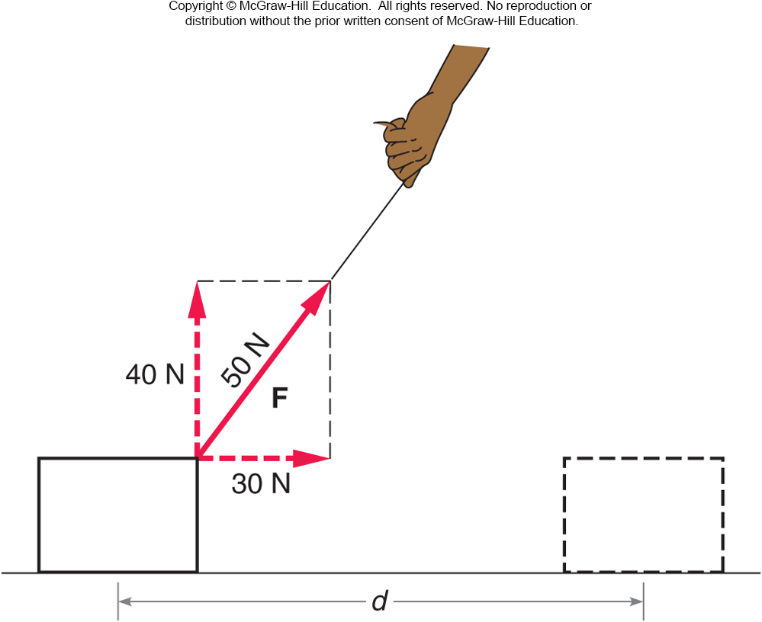
Only forces parallel to the motion do work.
In this case, with the block sliding horizontally, only the 30N part of the diagonal force does work.

Slide 11
Power is the rate of doing work
Power = Work divided by Time: P = W / t
units: 1 watt (W) = 1 J / s

Slide 12
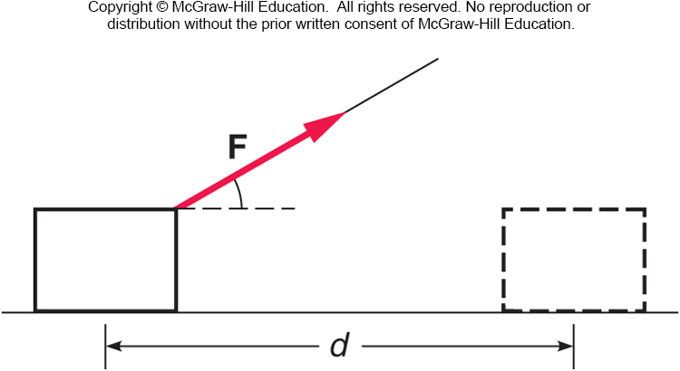
A string is used to pull a wooden block across the floor without accelerating the block. The string makes an angle to the horizontal. Does the force applied via the string do work on the block?
Yes, the force F does work.
No, the force F does no work.
Only part of the force F does work.
You can’t tell from this diagram.
Only the part of the force that is parallel to the distance moved does work on the block. This is the horizontal part of the force F.

Slide 13
If there is a frictional force opposing the motion of the block, does this frictional force do work on the block?
Yes, the frictional force does work.
No, the frictional force does no work.
Only part of the frictional force does work.
You can’t tell from this diagram.
Since the frictional force is antiparallel to the distance moved, it does negative work on the block.

Slide 14
Does the normal force of the floor pushing upward on the block do any work?
Yes, the normal force does work.
No, the normal force does no work.
Only part of the normal force does work.
You can’t tell from this diagram.
Since the normal force is perpendicular to the distance moved, it does no work on the block.

Slide 15
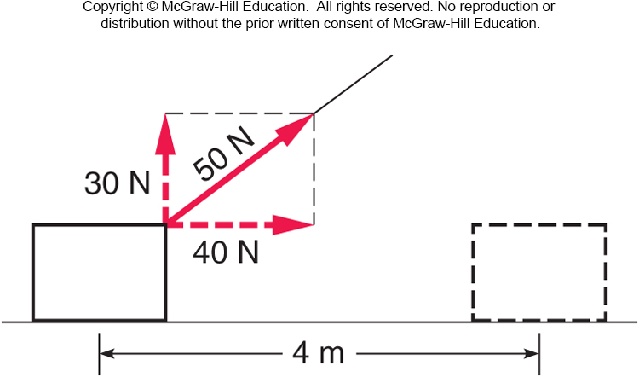
What is the total work done by the 50-N force?
120 J
160 J
200 J
280 J
0 J
Only the component of force in the direction of motion does work:
W = F · d
= (40 N) · (4 m)
= 160 J.

Slide 16
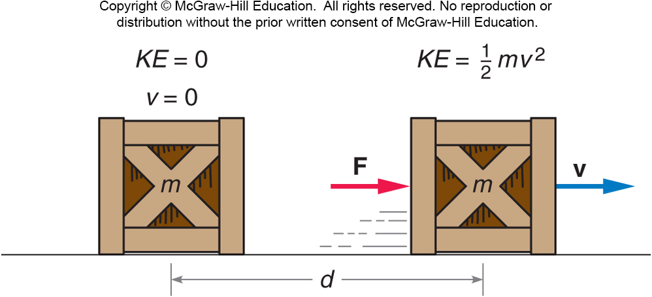
Kinetic Energy
Kinetic energy is the energy associated with an object’s motion.
Doing work on an object increases its kinetic energy.
Work done = change in kinetic energy

Slide 17
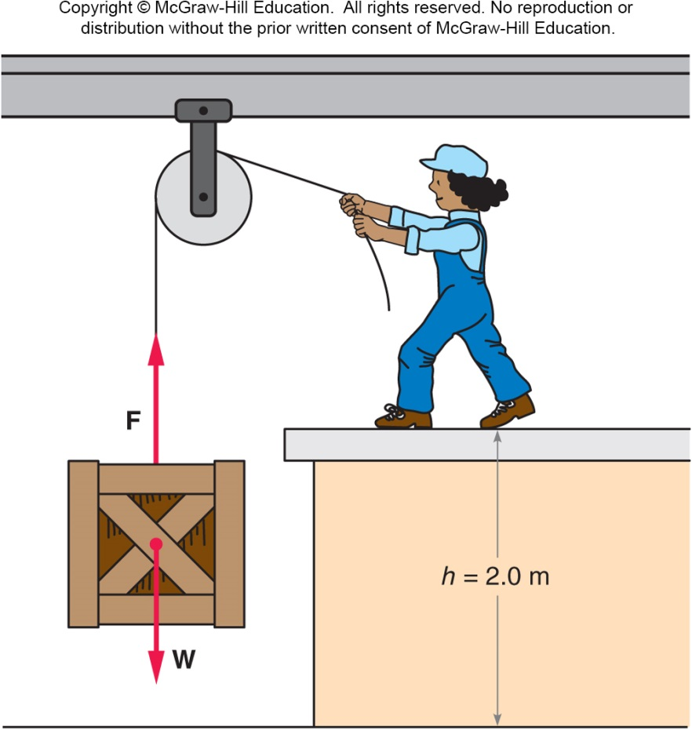
Potential Energy
If work is done but no kinetic energy is gained, we say that the potential energy has increased.
For example, if a force is applied to lift a crate, the gravitational potential energy of the crate has increased.
The work done is equal to the force (mg) times the distance lifted (height).
The gravitational potential energy equals mgh.

Slide 18
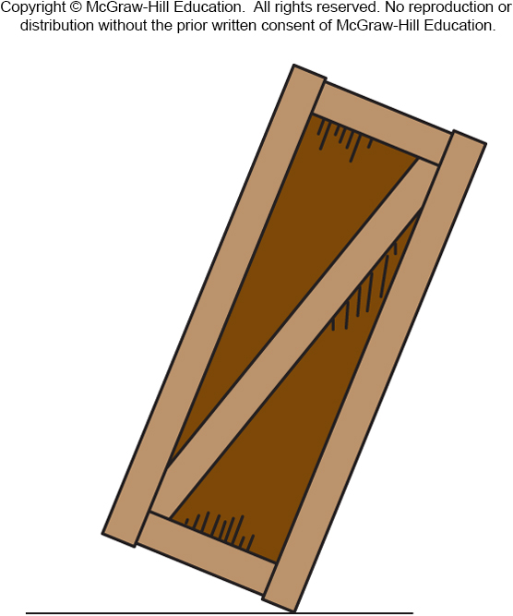
Work is done on a large crate to tilt the crate so that it is balanced on one edge, rather than sitting squarely on the floor as it was at first. Has the potential energy of the crate increased?
Yes
No
Yes. The center of the crate has been lifted slightly. If it is released it will fall back and convert the potential energy into kinetic energy.

Slide 19
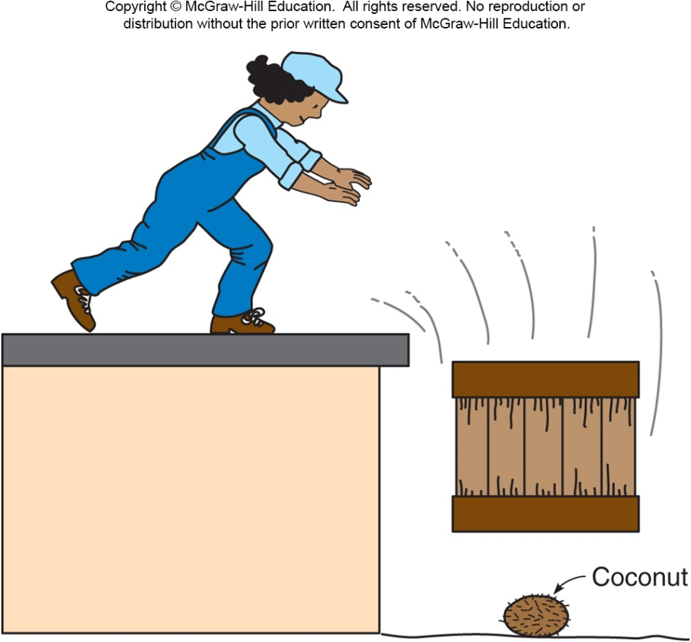
Potential Energy
The term potential energy implies storing energy to use later for other purposes.
For example, the gravitational potential energy of the crate can be converted to kinetic energy and used for other purposes.

Slide 20
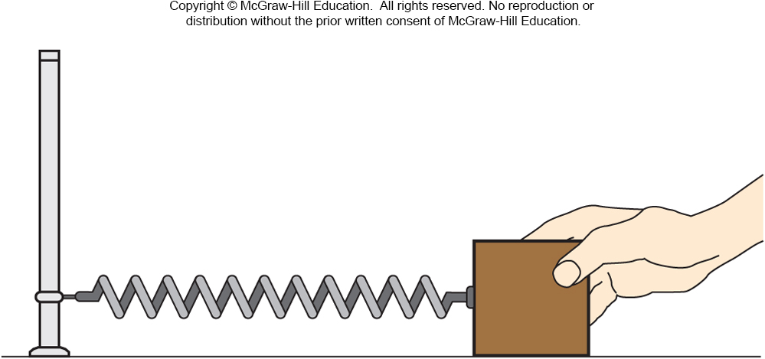
Potential Energy
An elastic force is a force that results from stretching or compressing an object.
Elastic potential energy is the energy gained when work is done to stretch a spring.
The spring constant, k, is a number describing the stiffness of the spring.

Slide 21
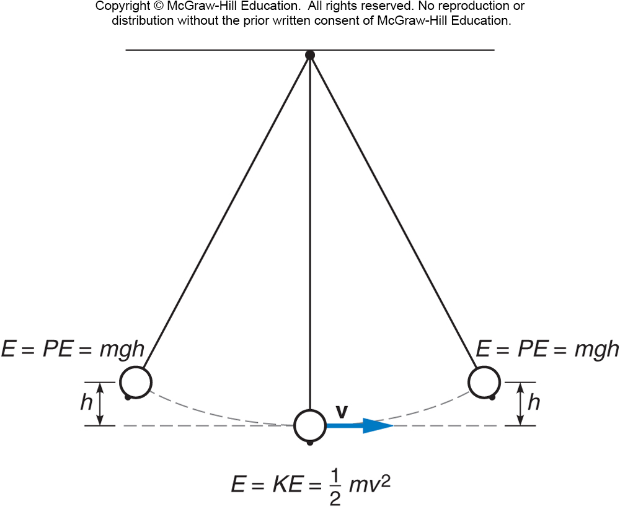
Conservative forces are forces for which the energy can be completely recovered.
Gravity and elastic forces are conservative.
Friction is not conservative.

Slide 22
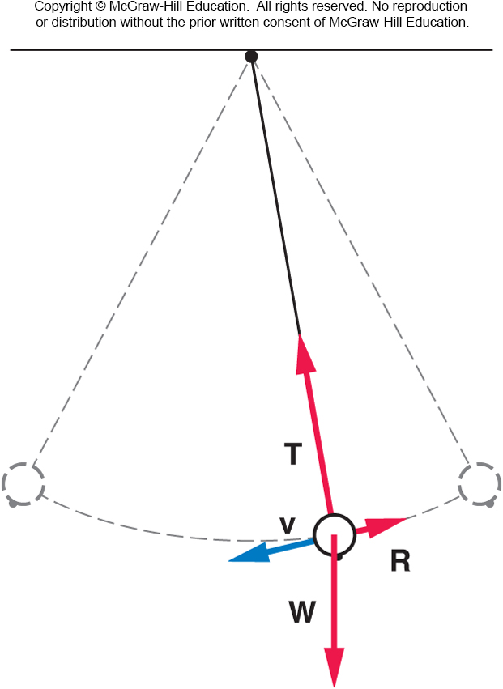
Conservation of Energy
Conservation of energy means the total energy (the kinetic plus potential energies) of a system remain constant.
Energy is conserved if there are no non-conservative forces doing work on the system.

Slide 23
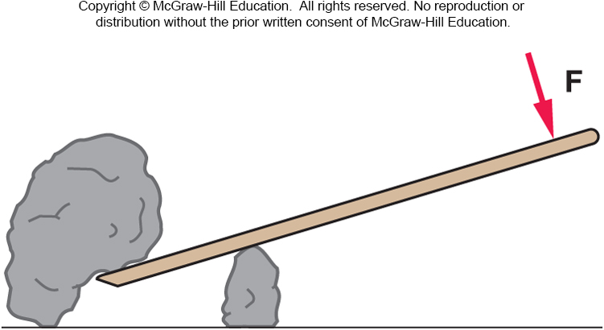
A lever is used to lift a rock. Will the work done by the person on the lever be greater than, less than, or equal to the work done by the lever on the rock?
Greater than
Less than
Equal to
Unable to tell
from this diagram
The work done by the person can never be less than the work done by the lever on the rock. If there are no dissipative forces they will be equal. This is a consequence of the conservation of energy.

Slide 24
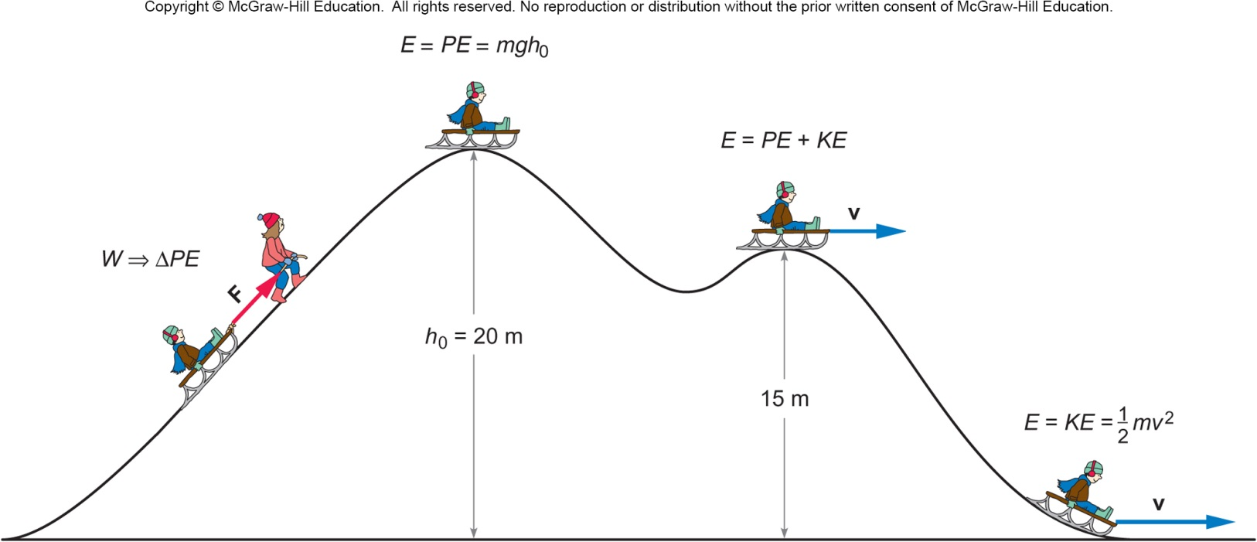
Work done in pulling a sled up a hill produces an increase in potential energy of the sled and rider.
This initial energy is converted to kinetic energy as they slide down the hill.

Slide 25
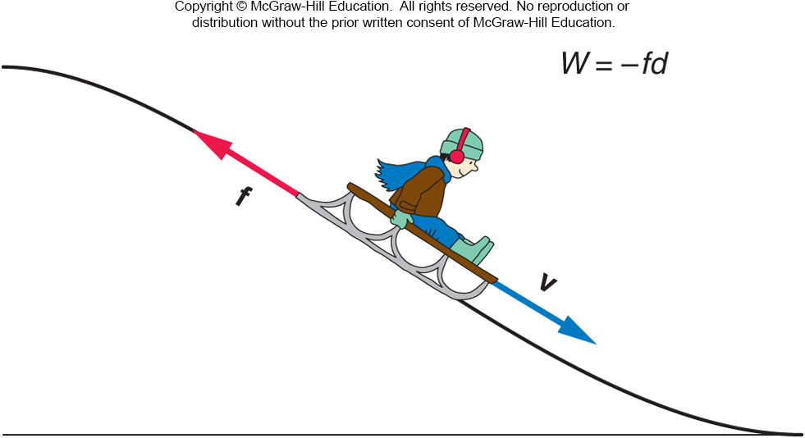
Any work done by frictional forces is negative.
That work removes mechanical energy from the system.

Slide 26
Simple Harmonic Motion

Slide 27
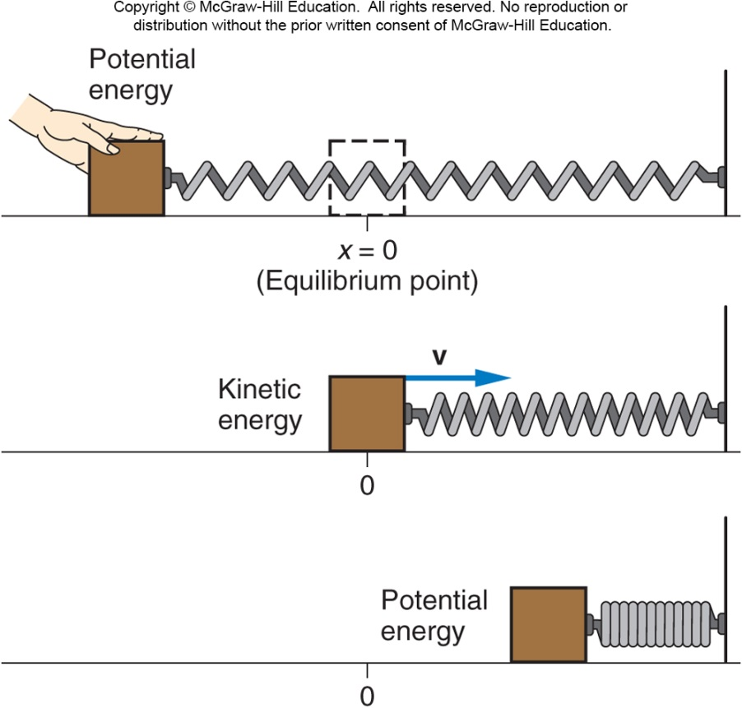
Springs and Simple Harmonic Motion
Simple harmonic motion occurs when the energy of a system repeatedly changes from potential energy to kinetic energy and back again.
Energy added by doing work to stretch the spring is transformed back and forth between potential energy and kinetic energy.

Slide 28
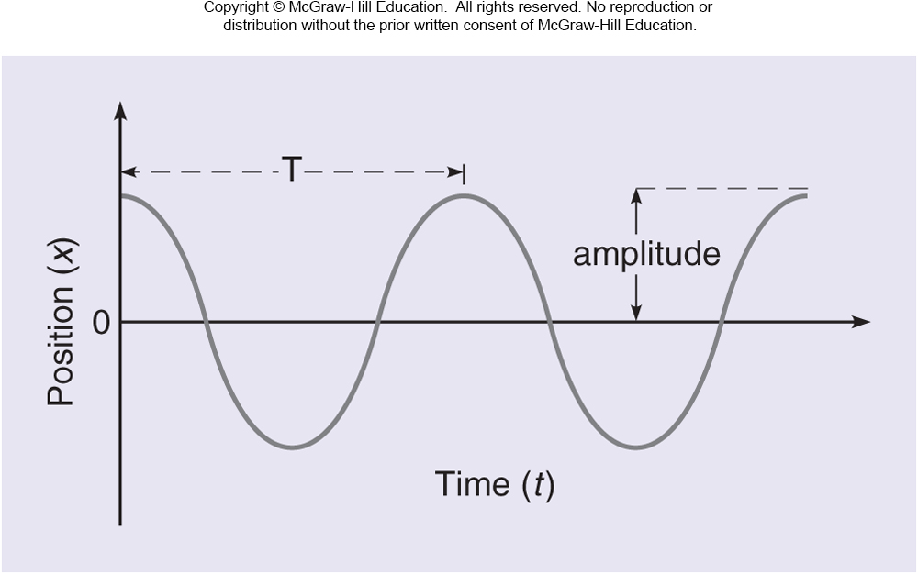
The horizontal position x of the mass on the spring is plotted against time as the mass moves back and forth.
The period T is the time taken for one complete cycle.
The frequency f is the number of cycles per unit time.
The amplitude is the maximum distance from equilibrium.

Slide 29
Momentum and Impulse

Slide 30
Collisions and Energy

Slide 31
Collisions
How can we describe the change in velocities of colliding football players, or balls colliding with bats?
How does a strong force applied for a very short time affect the motion?
Can we apply Newton’s Laws to collisions?
What exactly is momentum? How is it different from force or energy?
What does “Conservation of Momentum” mean?

Slide 32
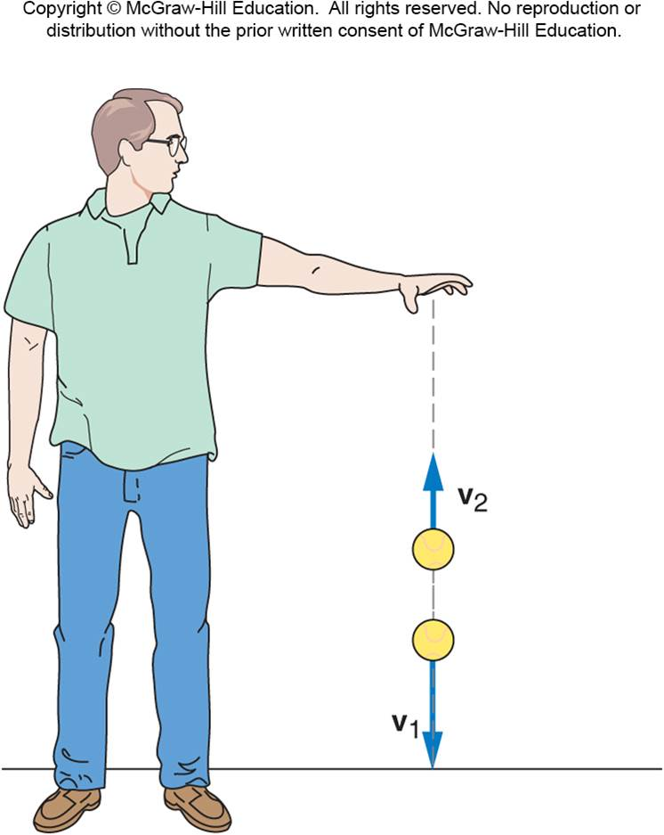
What happens when a ball bounces?
When it reaches the floor, its velocity quickly changes direction.
There must be a strong force exerted on the ball by the floor during the short time they are in contact.
This force provides the upward acceleration necessary to change the direction of the ball’s velocity.

Slide 33
What happens when a ball bounces?
Forces like this are difficult to analyze:
Strong forces that act for a very short time.
Forces that may change rapidly during the collision.
It will help to write Newton’s second law in terms of the total change in velocity over time, instead of acceleration:

Slide 34
Momentum and Impulse
Multiply both sides of Newton’s second
law by the time interval over which the
force acts:
The left side of the equation is impulse,
the (average) force acting on an object
multiplied by the time interval over which
the force acts.
How a force changes the motion of an object depends on both the size of the force and how long the force acts.
The right side of the equation is the change in the momentum of the object.
The momentum of the object is the mass of the object times its velocity.

Slide 35
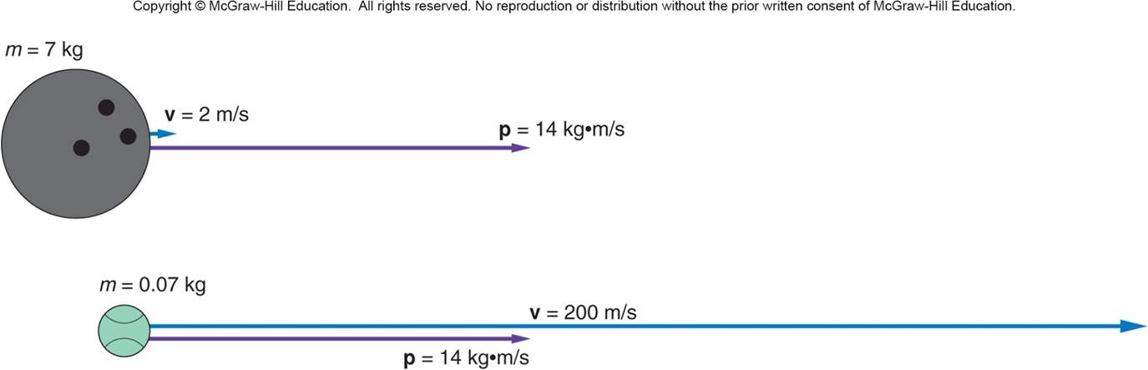
Momentum and Impulse
A bowling ball and a tennis ball can have the same momentum, if the tennis ball with its smaller mass has a much larger velocity.

Slide 36
Impulse-Momentum Principle
The impulse acting on an object produces a change in momentum of the object that is equal in both magnitude and direction to the impulse.

Slide 37
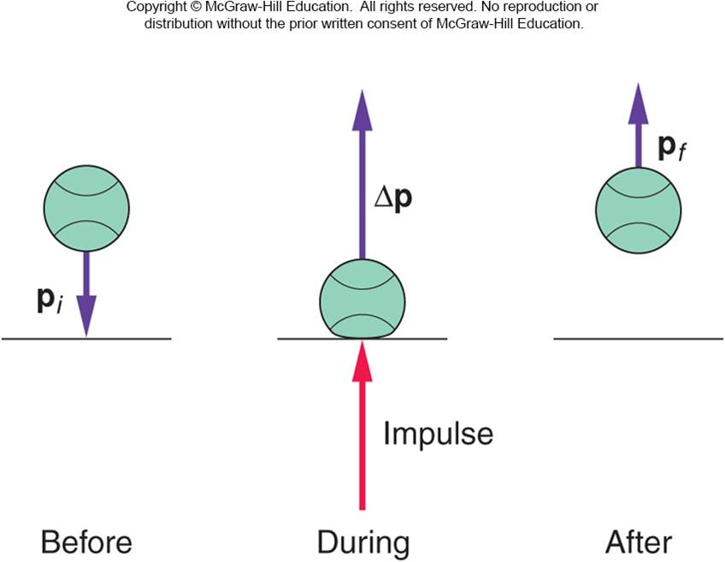
Impulse-Momentum Principle
When a ball bounces back with the same speed, the momentum changes from -mv to mv, so the change in momentum is 2mv.

Slide 38
Momentum…in space!

Slide 39
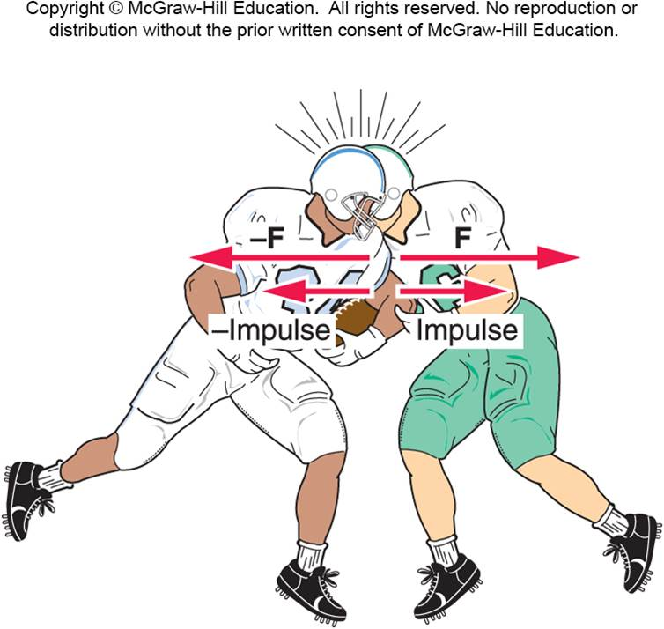
Conservation of Momentum
Does Newton’s third law still hold?
For every action, there is an equal but opposite reaction.
The defensive back exerts a force on the fullback, and the fullback exerts an equal but opposite force on the defensive back.

Slide 40
Conservation of Momentum
If the net external force acting on a system of objects is zero, the total momentum of the system is conserved.

Slide 41
Conservation of Momentum
The impulses on both are equal and opposite.
The changes in magnitude for each are equal and opposite.
The total change of the momentum for the two players is zero.

Slide 42
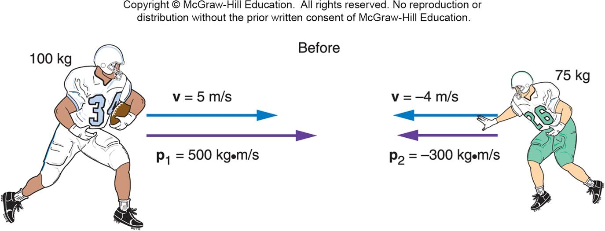
A 100-kg fullback moving straight downfield collides with a 75-kg defensive back. The defensive back hangs on to the fullback, and the two players move together after the collision. What is the initial momentum of each player?

Slide 43
What is the initial momentum of each player?
Fullback:
p = mv
= (100 kg)(5 m/s)
= 500 kg·m/s²
Defensive back:
p = mv
= (75 kg)(-4 m/s)
= -300 kg·m/s²

Slide 44
What is the total momentum of the system?
Total momentum:
p_{total} = p_{fullback} + p_{defensive back}
= 500 kg·m/s - 300 kg·m/s
= 200 kg·m/s

Slide 45
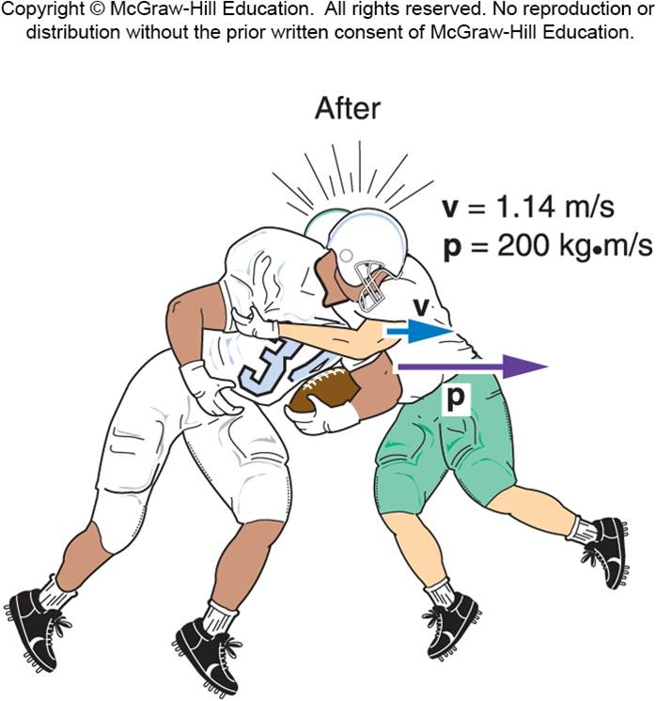
What is the velocity of the two players immediately after the collision?
Total mass:
m = 100 kg + 75 kg
= 175 kg
Velocity of both:
v = p_{total} / m
= (200 kg·m/s) / 175 kg
= 1.14 m/s

Slide 46
Recoil
Why does a shotgun slam against your shoulder when fired, sometimes painfully?
How can a rocket accelerate in empty space when there is nothing there to push against except itself?

Slide 47
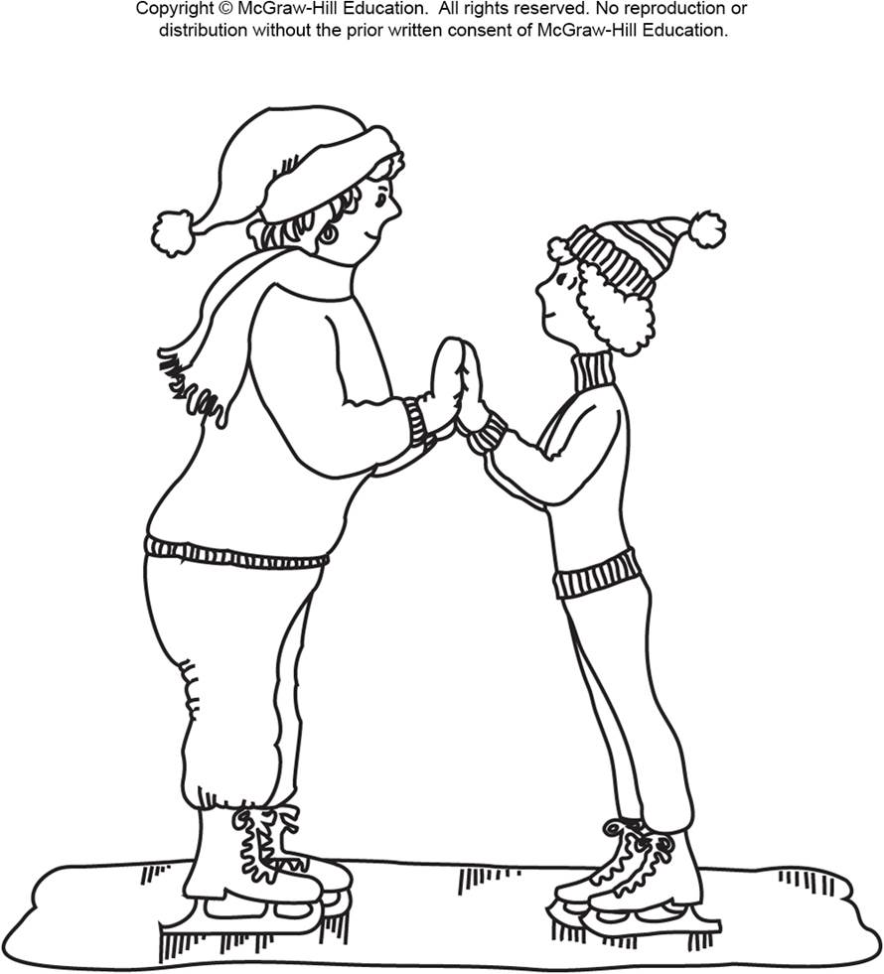
Two skaters of different masses prepare to push off against one another. Which one will gain the larger velocity?
The more massive one
The less massive one
They will each have equal but opposite velocities.
The less massive one!
The net external force acting on the system is zero, so conservation of momentum applies.
Before the push-off, the total initial momentum is zero.
The total momentum after the push-off should also be zero.

Slide 48
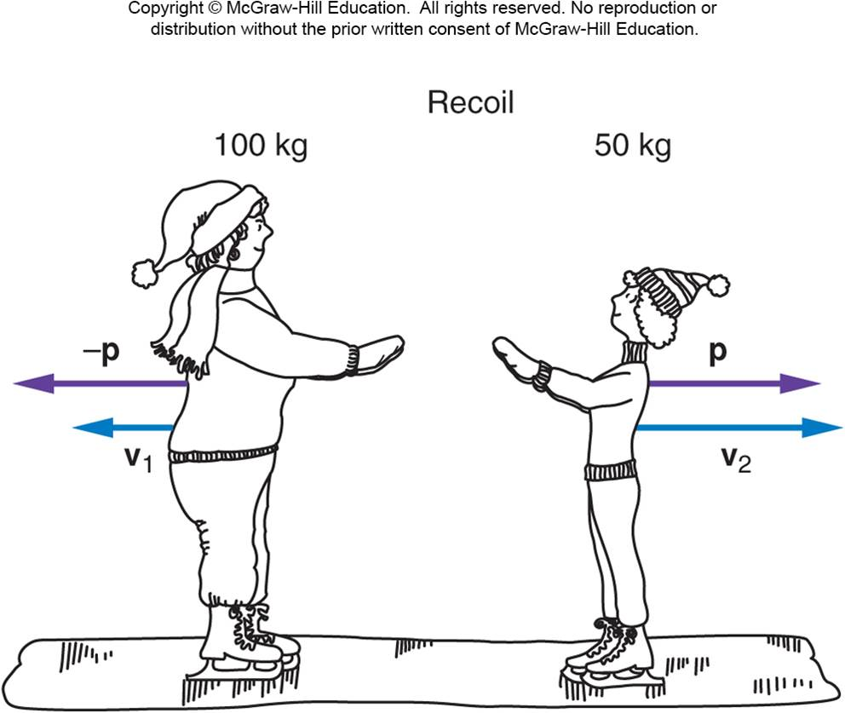
Recoil is what happens when a brief force between two objects causes the objects to move in opposite directions.
The lighter object attains the larger velocity to equalize the magnitudes of the momentums of the two objects.
The total momentum of the system is conserved and does not change.

Slide 49
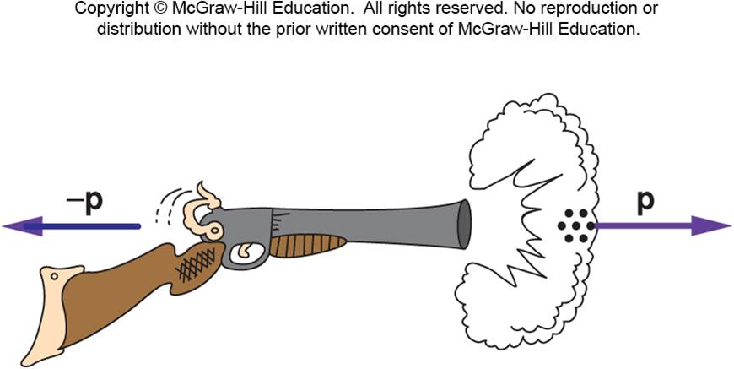
Is momentum conserved when shooting a shotgun?
The explosion of the powder causes the shot to move very rapidly forward.
If the gun is free to move, it will recoil backward with a momentum equal in magnitude to the momentum of the shot.

Slide 50
Gun Recoil

Slide 51
Even though the mass of the shot is small, its momentum is large due to its large velocity.
The shotgun recoils with a momentum equal in magnitude to the momentum of the shot.
The recoil velocity of the shotgun will be smaller than the shot’s velocity because the shotgun has more mass, but it can still be sizeable.

Slide 52
How can you avoid a bruised shoulder?
If the shotgun is held firmly against your shoulder, it doesn’t hurt as much.
WHY?

Slide 53
If you think of the system as just the shotgun and the pellets, then your shoulder applies a strong external force to the system.
Since conservation of momentum requires the external force to be zero, the momentum of this system is not conserved.

Slide 54
If you think of the system as including yourself with your shoulder against the shotgun, then momentum is conserved because all the forces involved are internal to this system (except possibly friction between your feet and the earth).
With your mass added to the system, the recoil velocity is smaller.

Slide 55
Recoil – Rockets

Slide 56
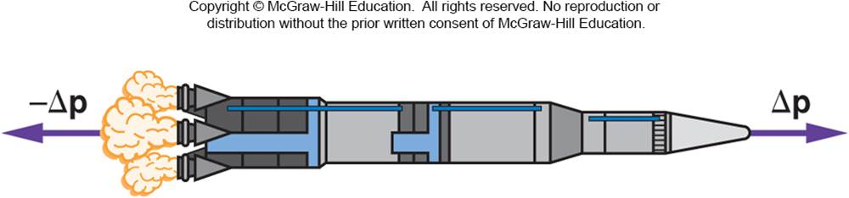
How does a rocket accelerate in empty space when there is nothing to push against?
The exhaust gases rushing out of the tail of the rocket have both mass and velocity and, therefore, momentum.
The momentum gained by the rocket in the forward direction is equal to the momentum of the exhaust gases in the opposite direction.
The rocket and the exhaust gases push against each other.
Newton’s third law applies.

Slide 57
Energy – Metal Foam

Slide 58
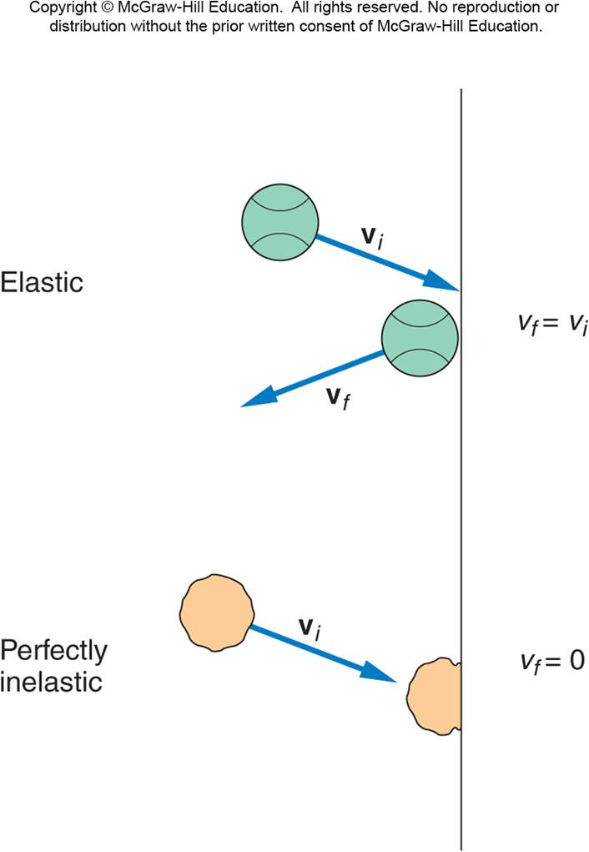
Elastic and Inelastic Collisions
Different kinds of collisions produce different results.
Sometimes the objects stick together.
Sometimes the objects bounce apart.
What is the difference between these types of collisions?
Is energy conserved as well as momentum?

Slide 59
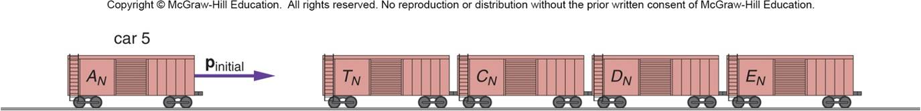
Elastic and Inelastic Collisions
A collision in which the objects stick together after collision is called a perfectly inelastic collision.
The objects do not bounce at all.
If we know the total momentum before the collision, we can calculate the final momentum and velocity of the now-joined objects.
For example:
The football players who stay together after colliding.
Coupling railroad cars.

Slide 60
Four railroad cars, all with the same mass of 20,000 kg, sit on a track. A fifth car of identical mass approaches them with a velocity of 15 m/s. This car collides and couples with the other four cars. What is the initial momentum of the system?
m₅ = 20,000 kg
v₅ = 15 m/s
p_{initial} = m₅v₅
= (20,000 kg)(15 m/s)
= 300,000 kg·m/s
200,000 kg·m/s
300,000 kg·m/s
600,000 kg·m/s
1,200,000 kg·m/s

Slide 61
What is the velocity of the five coupled cars after the collision?
1 m/s
3 m/s
5 m/s
10 m/s
m_{total} = 100,000 kg
p_{final} = p_{initial}
v_{final} = p_{final} / m_{total}
= (300,000 kg·m/s)/(100,000 kg)
= 3 m/s

Slide 62
Is the kinetic energy after the railroad cars collide equal to the original kinetic energy of car 5?
KE_{initial} = 1/2 m₅ v₅²
= 1/2 (20,000 kg)(15 m/s)²
= 2250 kJ
KE_{final} = 1/2 m_{total} v_{final}²
= 1/2 (100,000 kg)(3 m/s)²
= 450 kJ
KE_{final} ≠ KE_{initial}
yes
no
It depends.
No, in fact it is substantially less than the initial kinetic energy!

Slide 63
Elastic and Inelastic Collisions
Energy is not conserved in a perfectly inelastic collision.
If the objects bounce apart instead of sticking together, the collision is either elastic or partially inelastic.
An elastic collision is one in which no energy is lost.
A partially inelastic collision is one in which some energy is lost, but the objects do not stick together.
The greatest portion of energy is lost in the perfectly inelastic collision, when the objects stick.

Slide 64
A ball bouncing off a floor or wall with no decrease in the magnitude of its velocity is an elastic collision.
The kinetic energy does not decrease.
No energy has been lost.
A ball sticking to the wall is a perfectly inelastic collision.
The velocity of the ball after the collision is zero.
Its kinetic energy is then zero.
All of the kinetic energy has been lost.
Most collisions involve some energy loss, even if the objects do not stick, because the collisions are not perfectly elastic.
Heat is generated, the objects may be deformed, and sound waves are created.
These would be partially inelastic collisions.

Slide 65
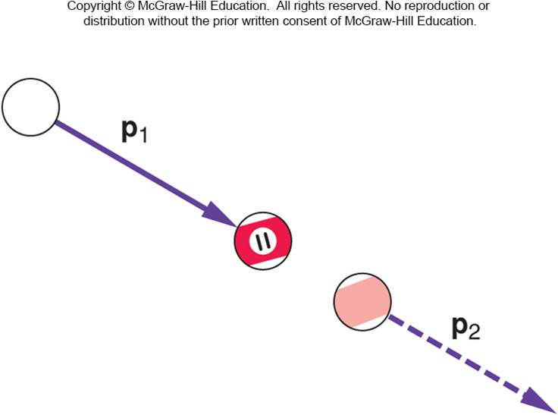
What happens when billiard balls bounce?
Simplest case: a head-on collision between the white cue ball and the eleven ball initially at rest.
If spin is not a factor, the cue ball stops and the eleven ball moves forward with a velocity equal to the initial velocity of the cue ball.
The eleven ball’s final momentum is equal to the cue ball’s initial momentum.
Momentum is conserved.
The eleven ball also has
a final kinetic energy
equal to the cue ball’s
initial kinetic energy.
Energy is conserved.

Slide 66
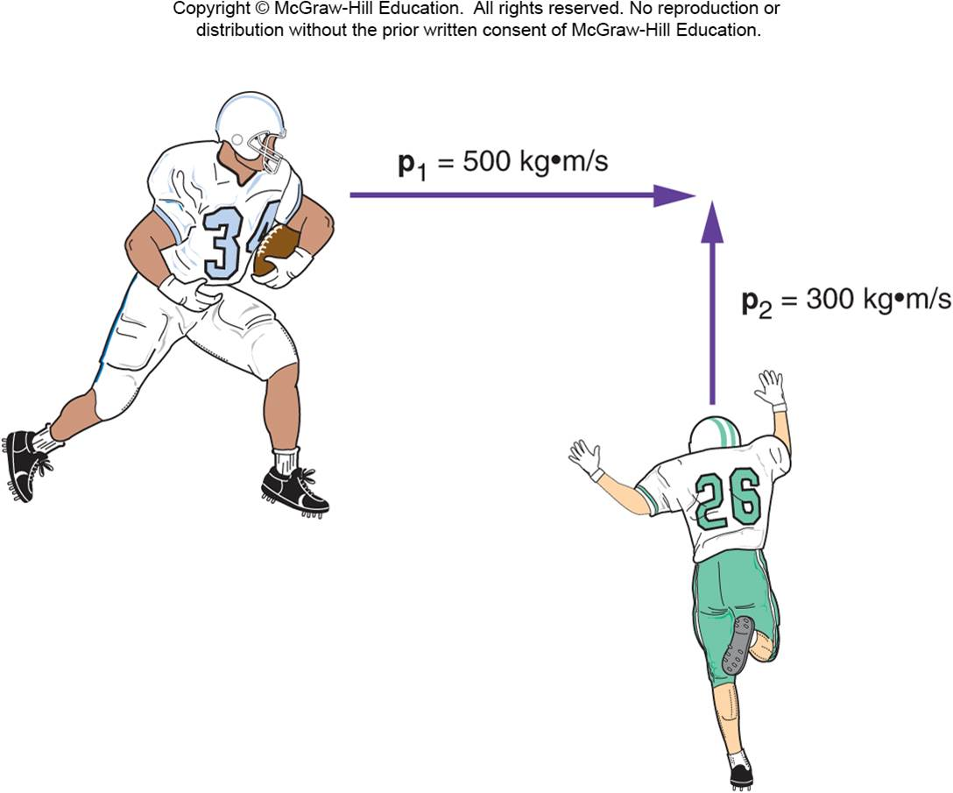
Collisions at an Angle
Two football players traveling at right angles to one another collide and stick together.
What will be their direction of motion after the collision?
Add the individual momentum vectors to get the total momentum of the system before the collision.
The final momentum of the two players stuck together is equal to the total initial momentum.

Slide 67
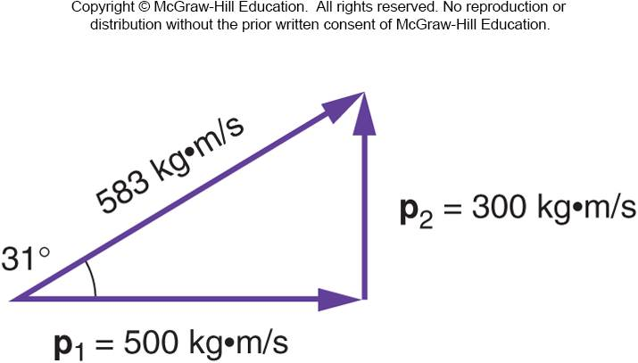
Collisions at an Angle
The total momentum of the two football players prior to the collision is the vector sum of their individual momentums.
The larger initial momentum has a larger effect on the final direction of motion.

Slide 68
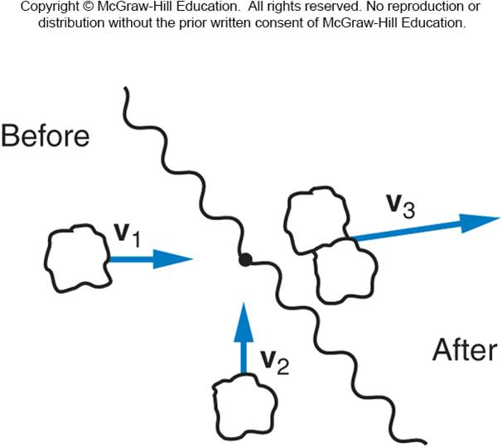
Two lumps of clay of equal mass are traveling at right angles with equal speeds as shown, when they collide and stick together. Is it possible that their final velocity vector is in the direction shown?
yes
no
unable to tell
from this graph
The final momentum will be in a direction making a 45º degree angle with respect to each of the initial momentum vectors.

Slide 69
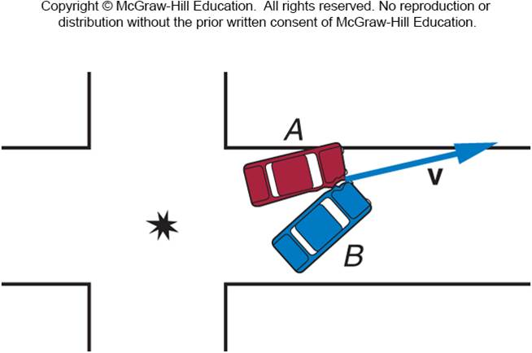
Two cars of equal mass Collide at right angles to one another in an intersection. Their direction of motion after the collision is as shown. Which car had the greater velocity before the collision?
Car A
Car B
Their velocities were equal in magnitude.
It is impossible to tell
from this graph.
Since the angle with respect to the original direction of A is smaller than 45º, car A must have had a larger momentum and thus was traveling faster.

